Slide 1
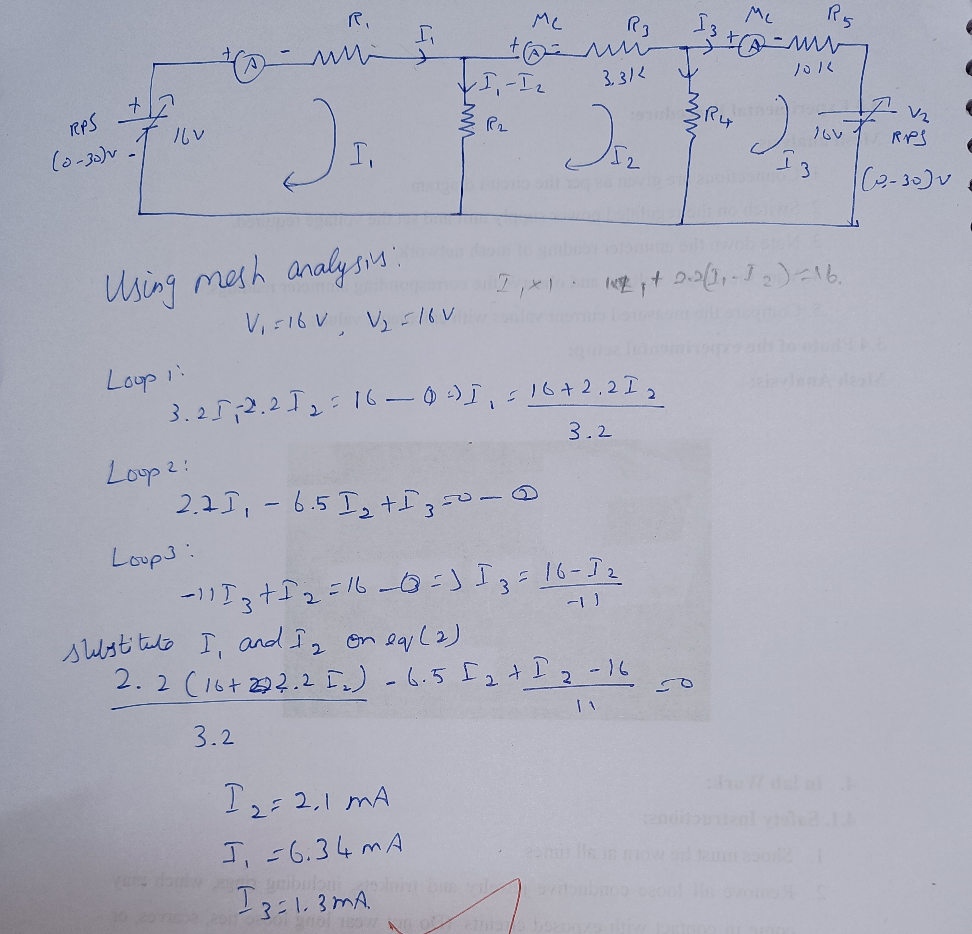
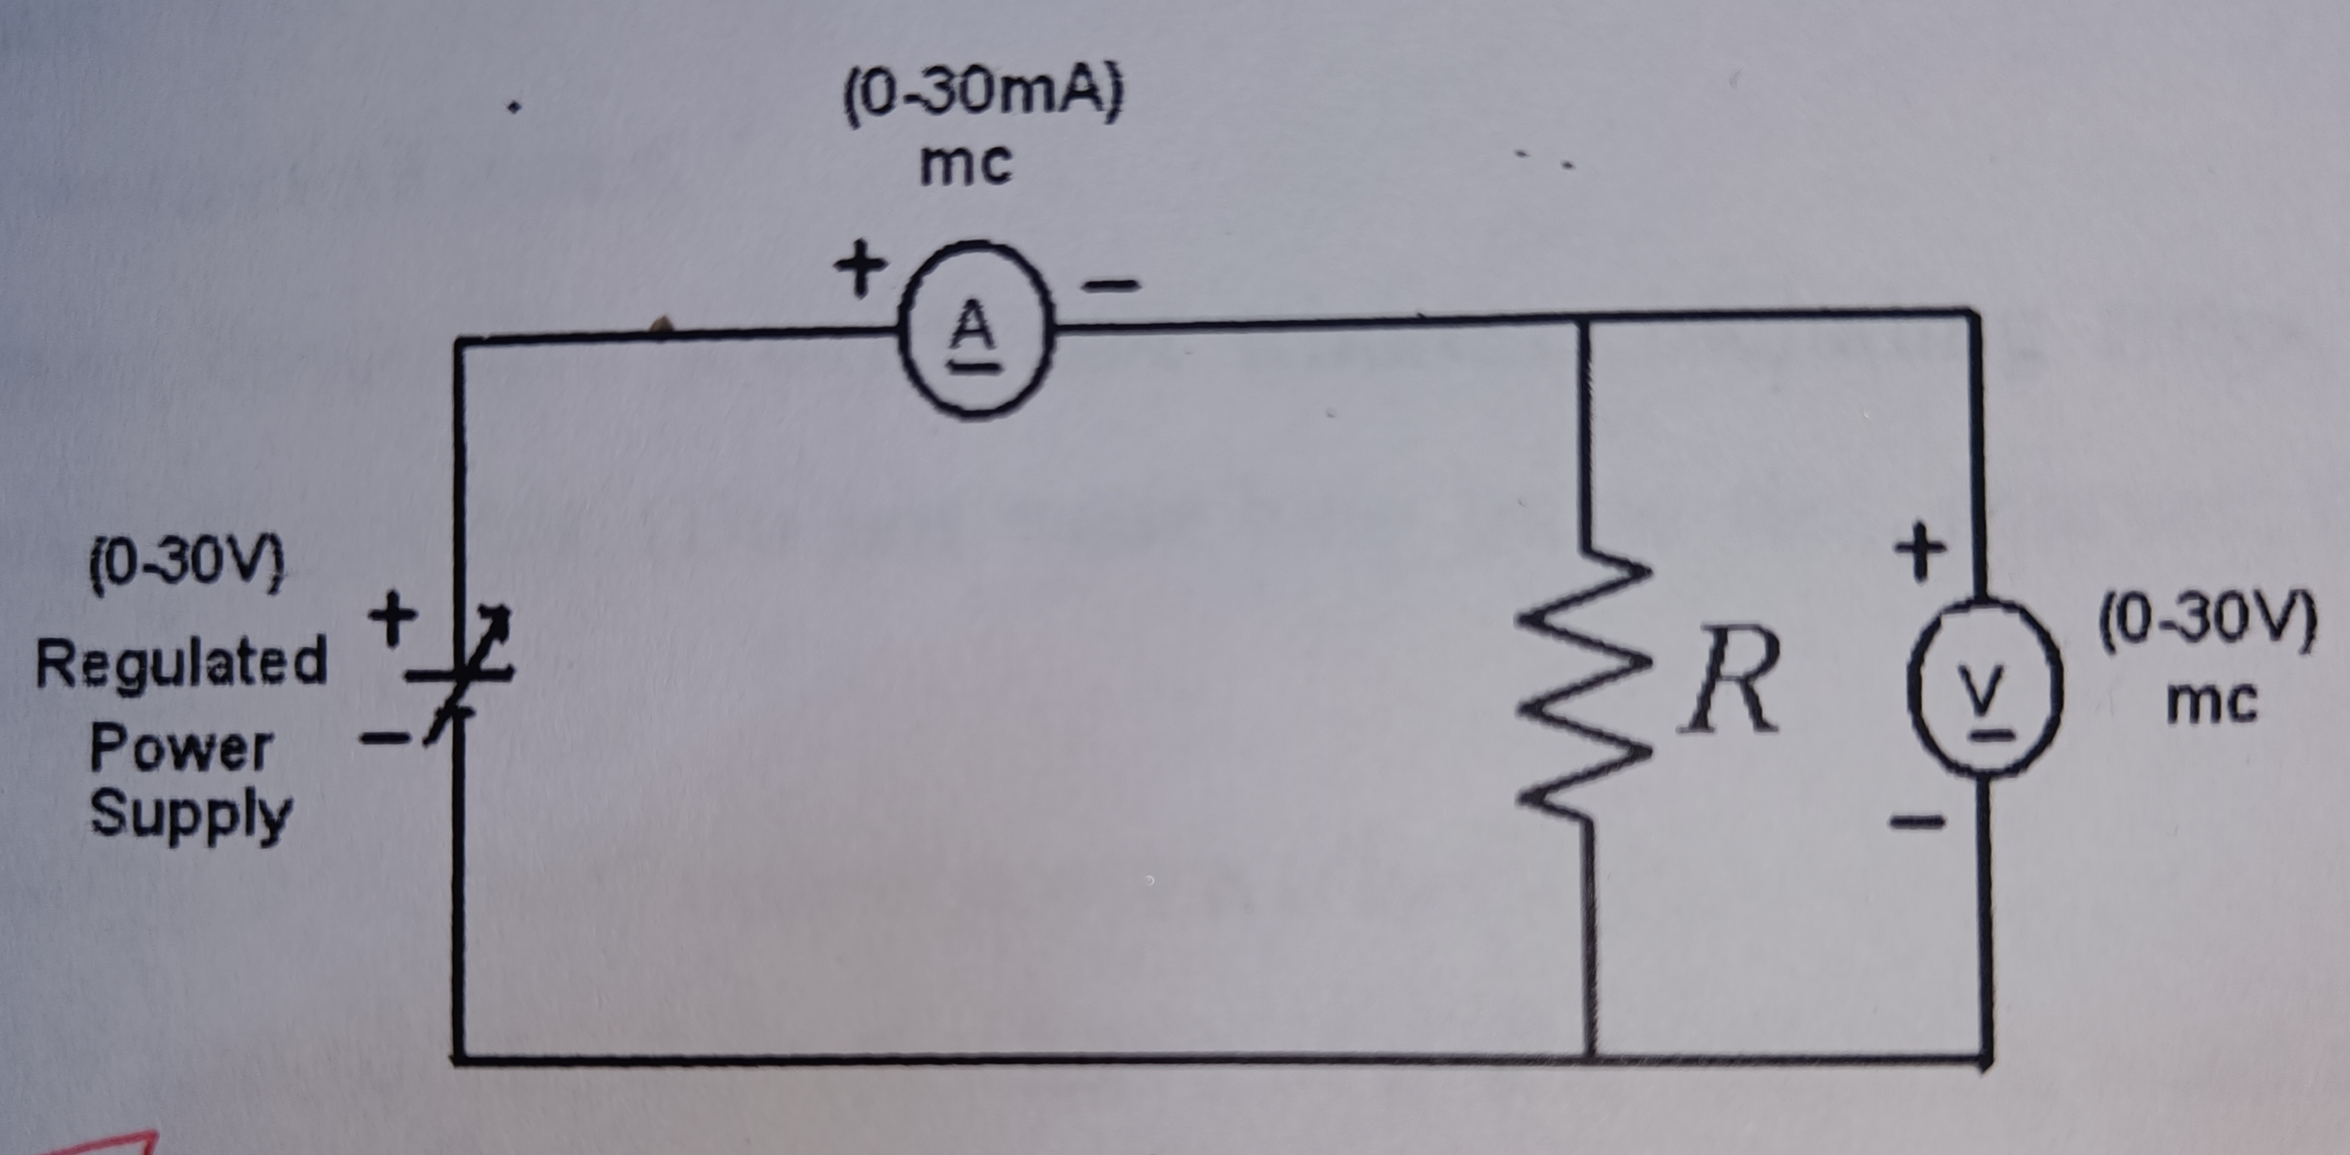
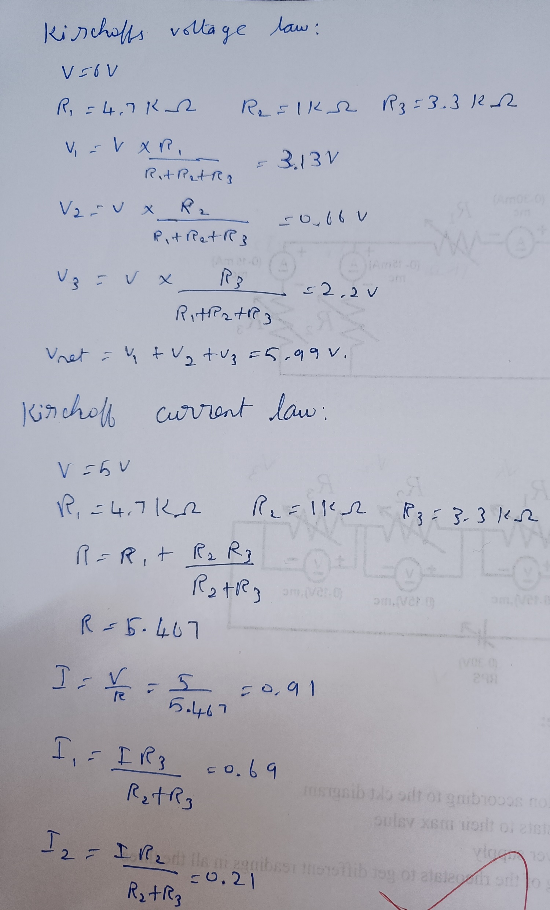
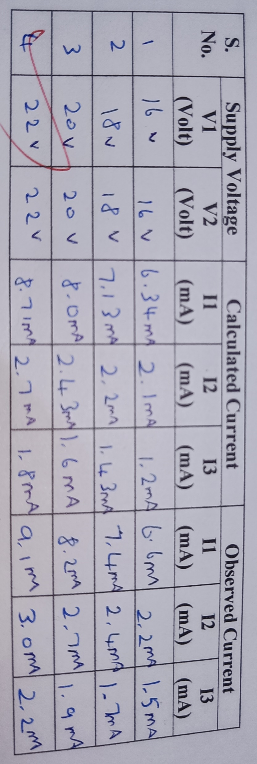
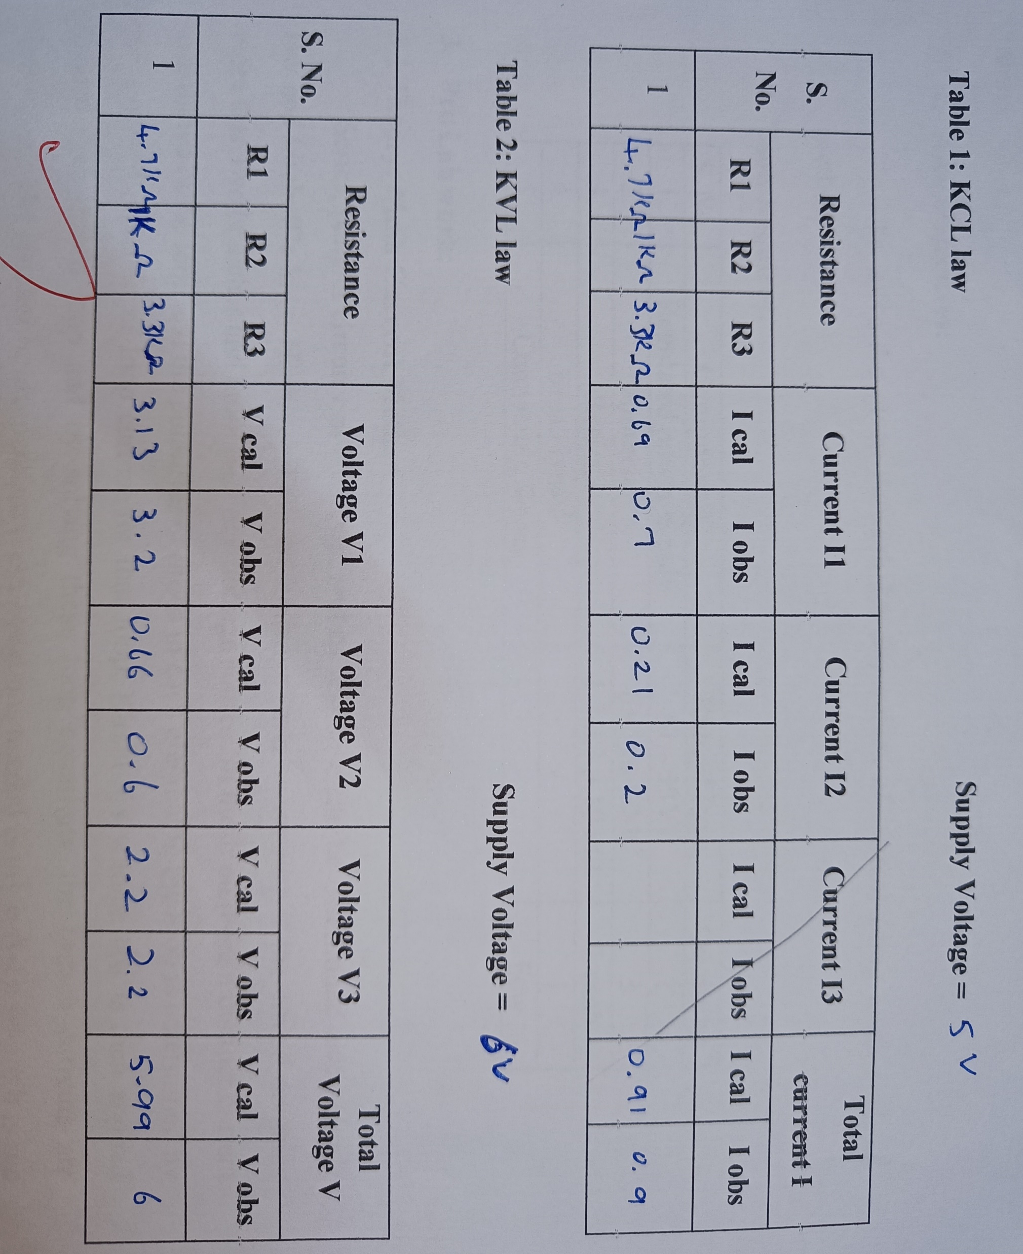
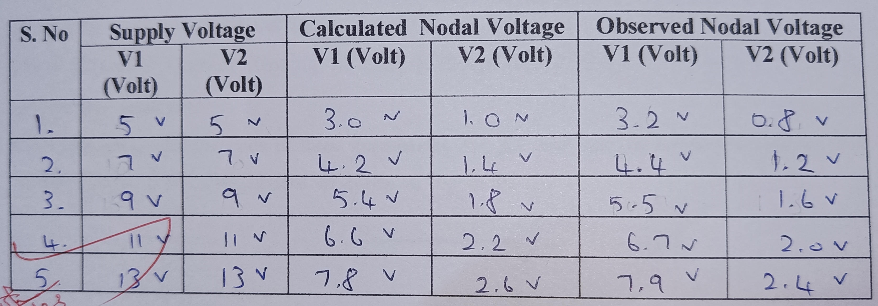
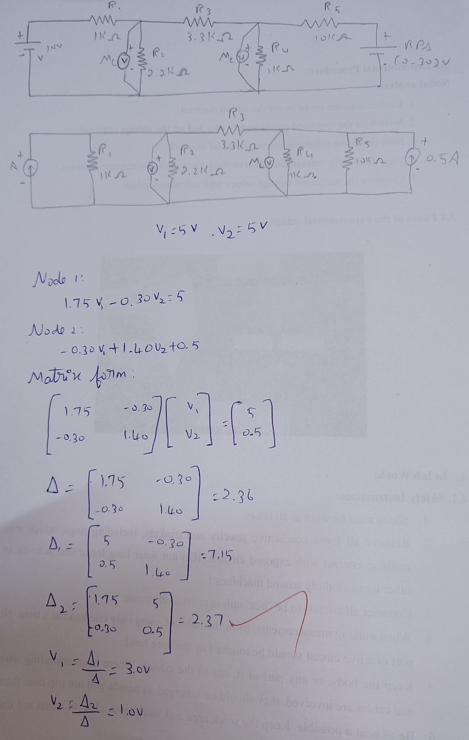
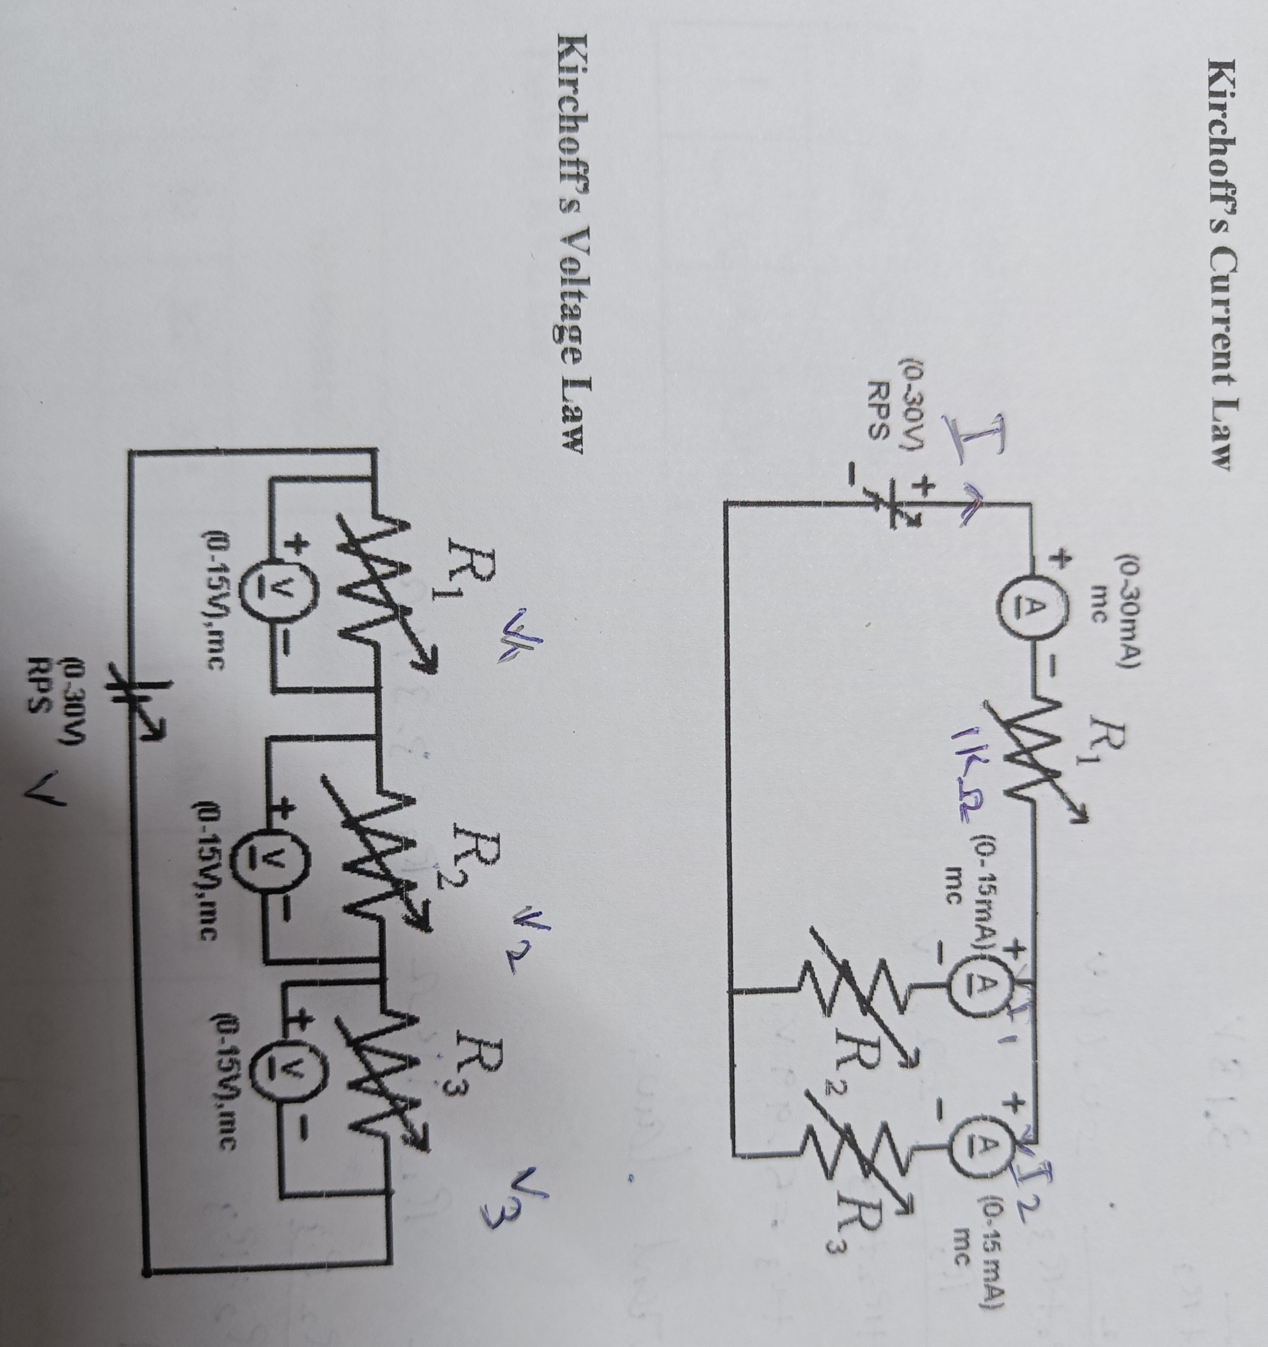
1. Objective: To verify experimentally
i) Kirchoff’s current Law
ii) Kirchoff’s voltage Law
2. Tools Required:
S. No. Components Range/Type Quantity
1. Regulated power supply 0 – 30V 1 2. Ammeter (0 -10mA),mc 1
3. Voltmeter (0 – 15V),mc 1 4. Resistor
5. Bread board – 1 6. Connecting Wires - Few
Procedure: KCL:::
1. Make the connection according to the ckt diagram
2. Set the three rheostats to their max value.
3. Switch on the power supply
4. Change the setting of the rheostats to get different readings in all the three ammeters.
5. Measure the current in the three ammeters
6. Check that at every time current in the main branch is equal to the
sum of currents
in the two branches. Repeat the setting of the rheostat.
7. Switch off the power supply.
KVL:
1. Connect the circuit as per the circuit diagram
2. Switch on the power supply 3. Note down the readings of the voltmeters
4. Change the value of the rheostat and repeat the step several times and switch off the power supply.
Mesh analysis 1. Aim: Objectives To solve the given network for the values of current using mesh analysis method.
Tools Required:
S. No. Components Range/Type Quantity
1. Regulated power supply (0 – 30V) 1
2. Ammeter (0-5)mA/MC 3
3. Resistor 1,2.2,3.3,10 kΩ 1 each
4. Bread board - 1
5. Connecting Wires - Few
Procedure Mesh analysis
1. Connections are given as per the circuit diagram.
2. Switch on the regulated power supply unit and set the voltage required.
3. Note down the ammeter reading of mesh network.
4. Vary the supply voltage and observe the corresponding ammeter readings.
5. Compare the measured current values with calculated values.
NODAL ANALYSIS 1. Aim: Objectives:
To solve the given network for the values of voltage using nodal analysis method.
2. Tools Required:
S. No. Components Range/Type Quantity
1. Regulated power supply (0 – 30V) 1
3. Voltmeter (0-30)V/ MC 2
4. Resistor 1,2.2,3.3,10 kΩ 1 each
5. Bread board - 1
6. Connecting Wires - Few
3.3 Experimental Procedure:
Nodal analysis
1. Connections are given as per the circuit diagram.
2. Switch on the regulated power supply unit and set the voltage required.
3. Note down the voltmeter reading of nodal network.
4. Vary the supply voltage and observe the corresponding voltmeter readings.
5. Compare the measured voltage values with calculated values.
OHMS LAW 1.Objective: *To verify the Ohm’s Law.
2.-Apparatus Required:
S. No. Components Range/Type Quantity
1. Regulated power supply 0 – 30V 1 2. Ammeter (0-30 mA), mc 1
3. Voltmeter (0-30 V), mc 1 4. Resistance box - 1
5. Bread board – 1 6. Connecting Wires - Few
=> 3.3 Experimental Procedure:
1. Connections are given as per the circuit diagram.
2. To start,check resistance of decade resistance boxes to be in
the minimum position.
3. Using the regulated power supply, supply voltage is varied.
4. Change the value of resistance in steps by using decade resistance box.
5. The corresponding reading in ammeters and voltmeters are noted.
6. The law is verified from the tabulated readings.
voltage R I I cal iobs
4.0 1 4.oma 4.oma
5.0 1Kohm 5.0 4.9ma
7.0 1 7.0 6.9
8.0 1 8.0 7.9
2

Slide 2
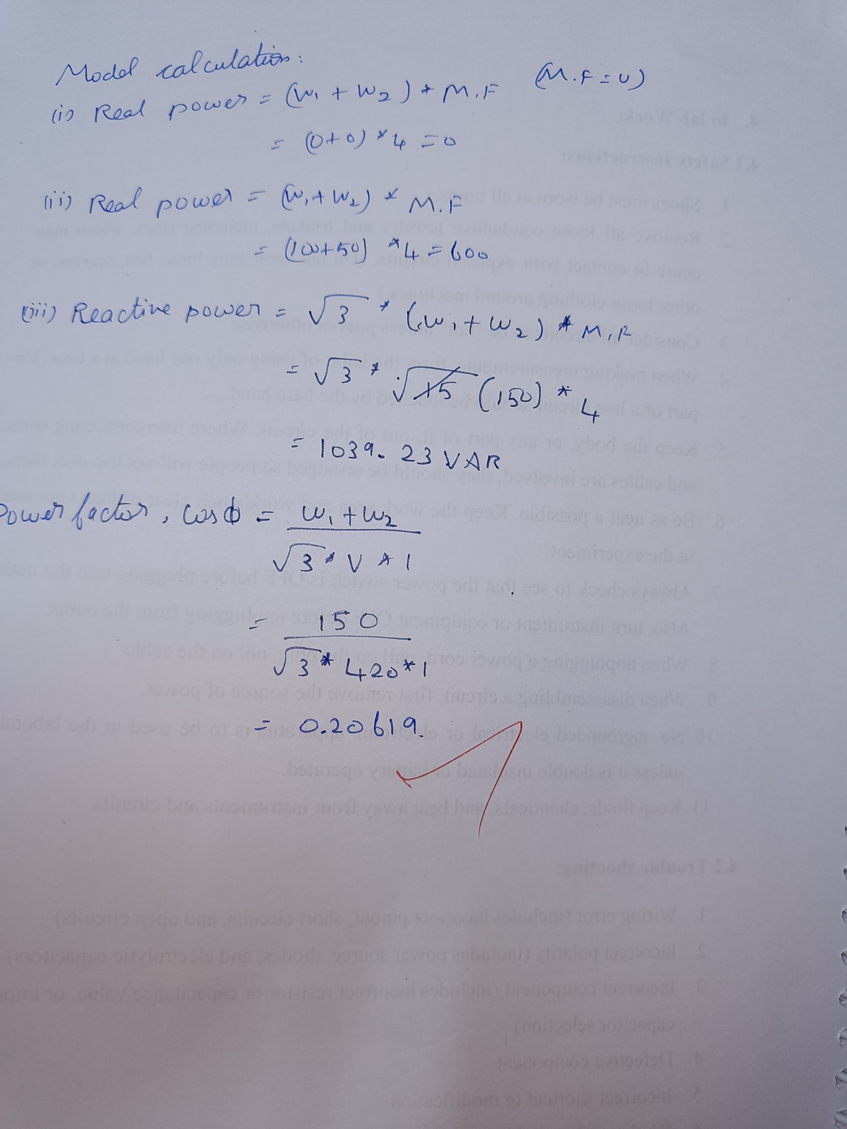
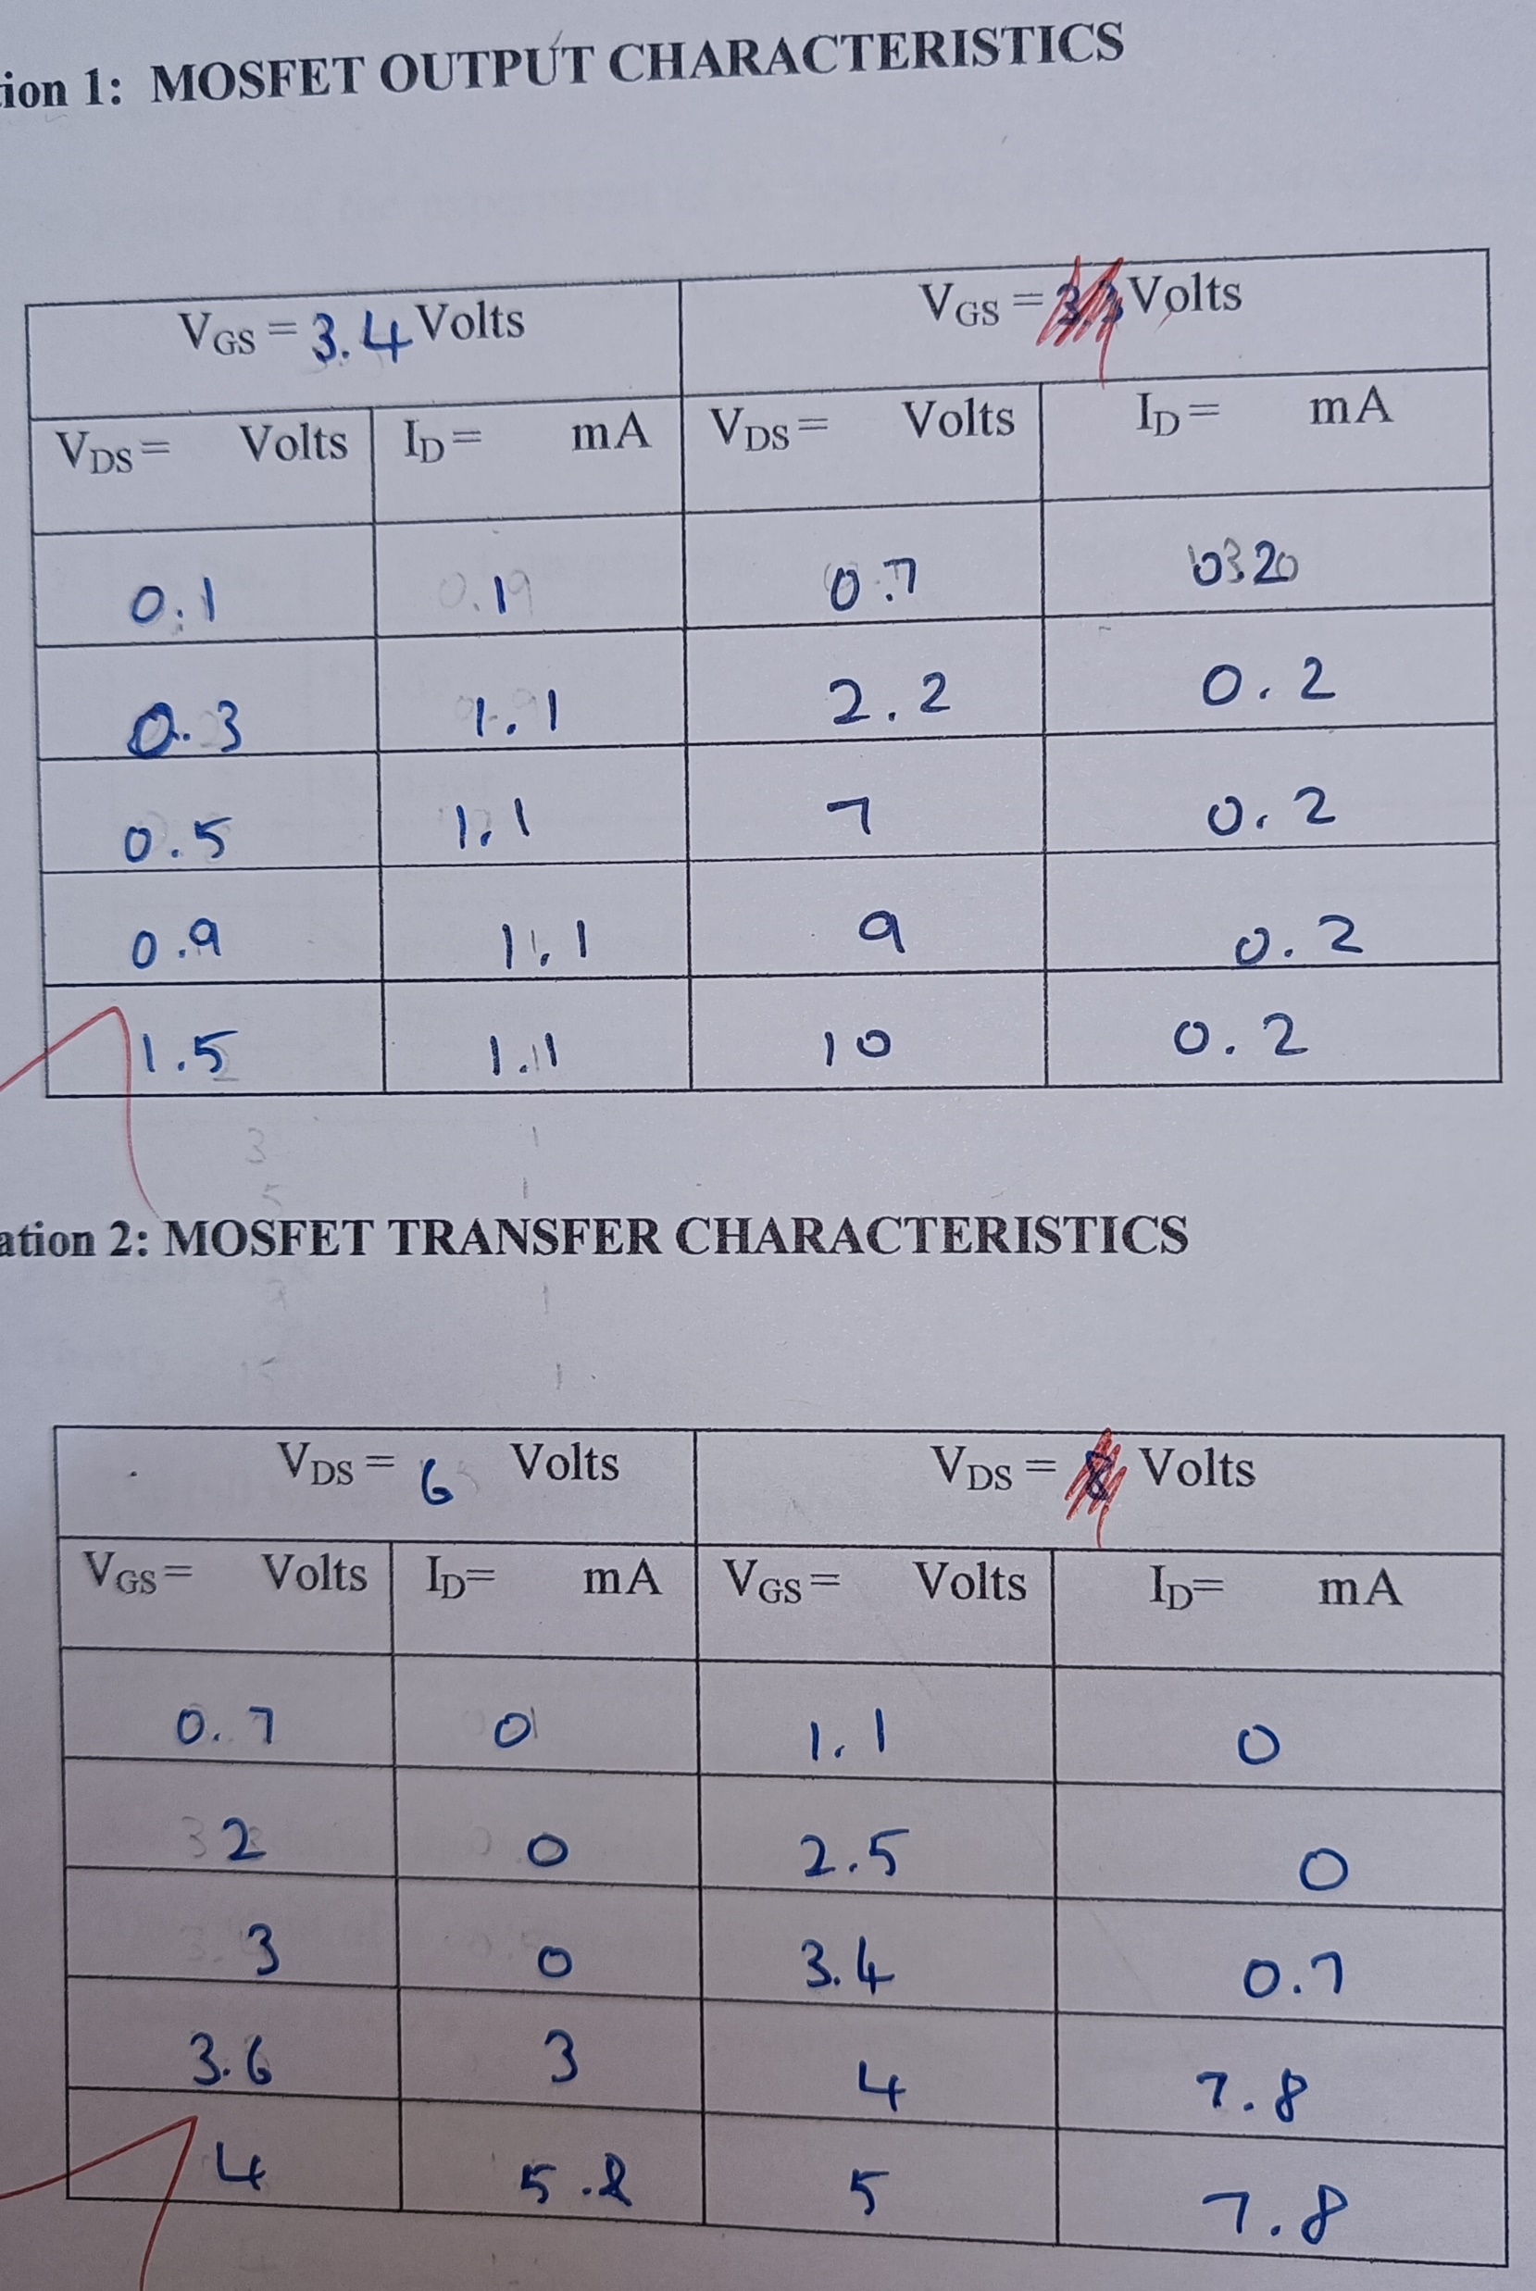
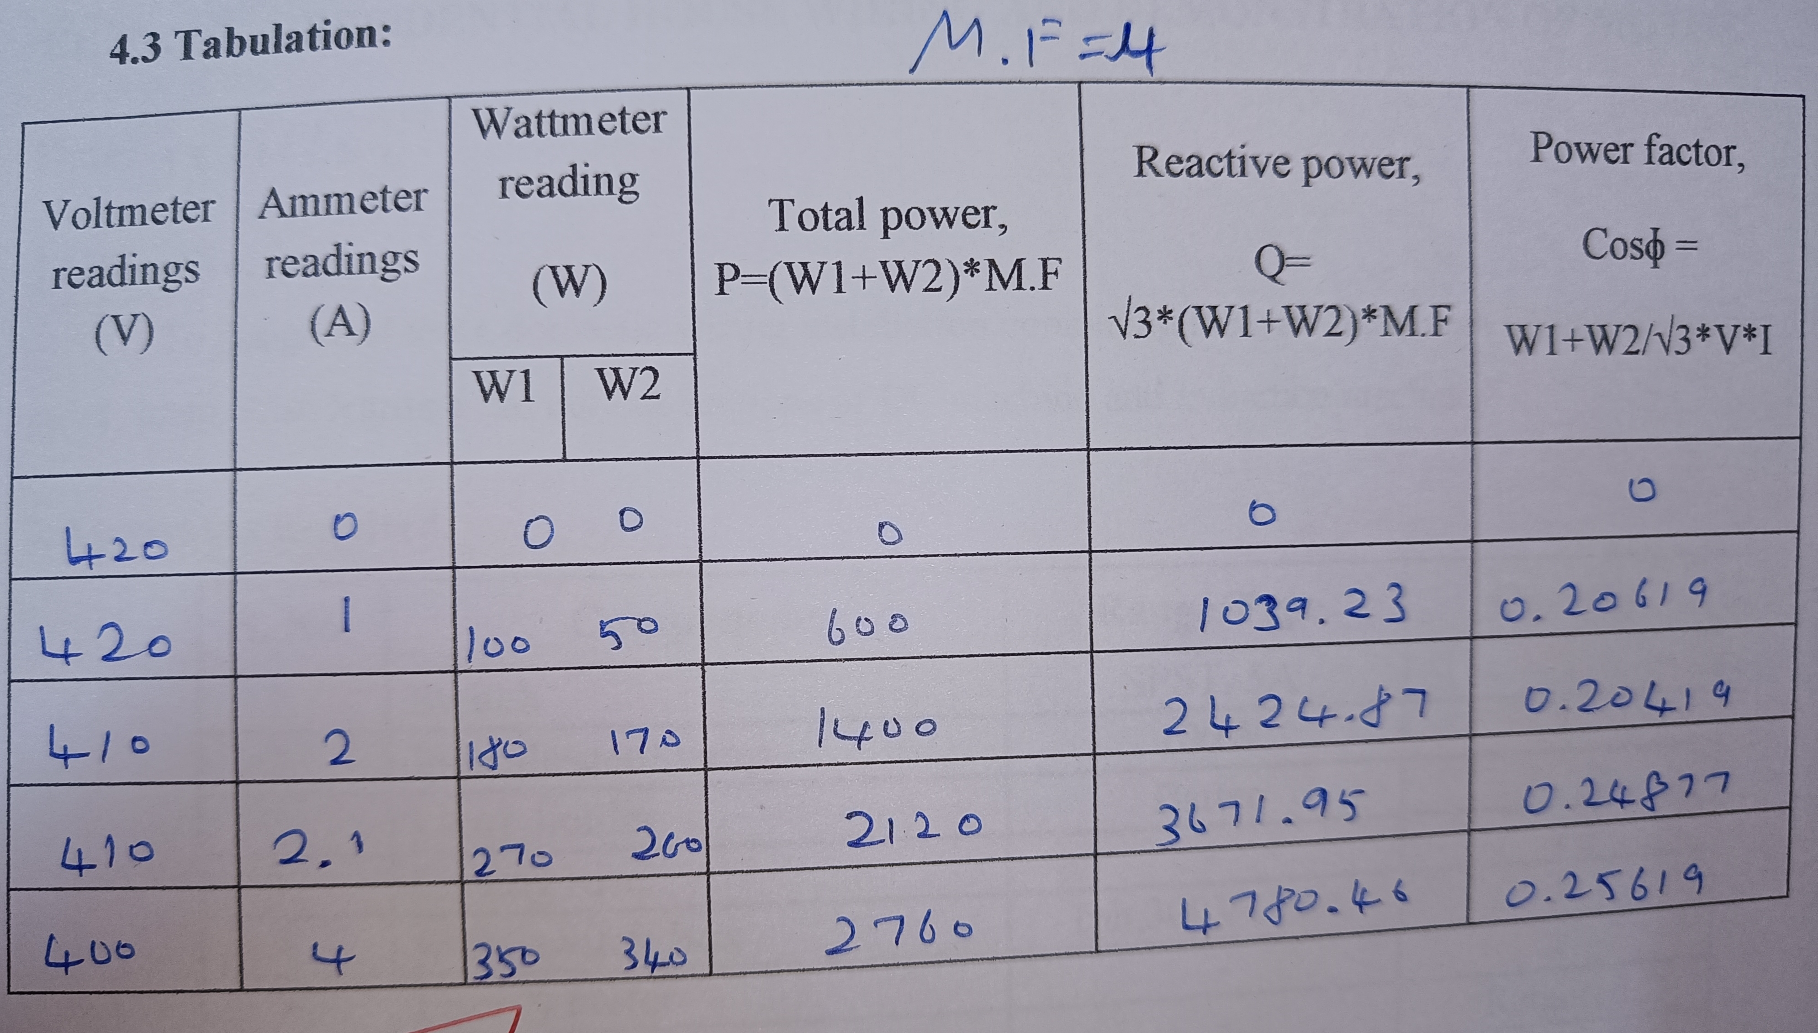
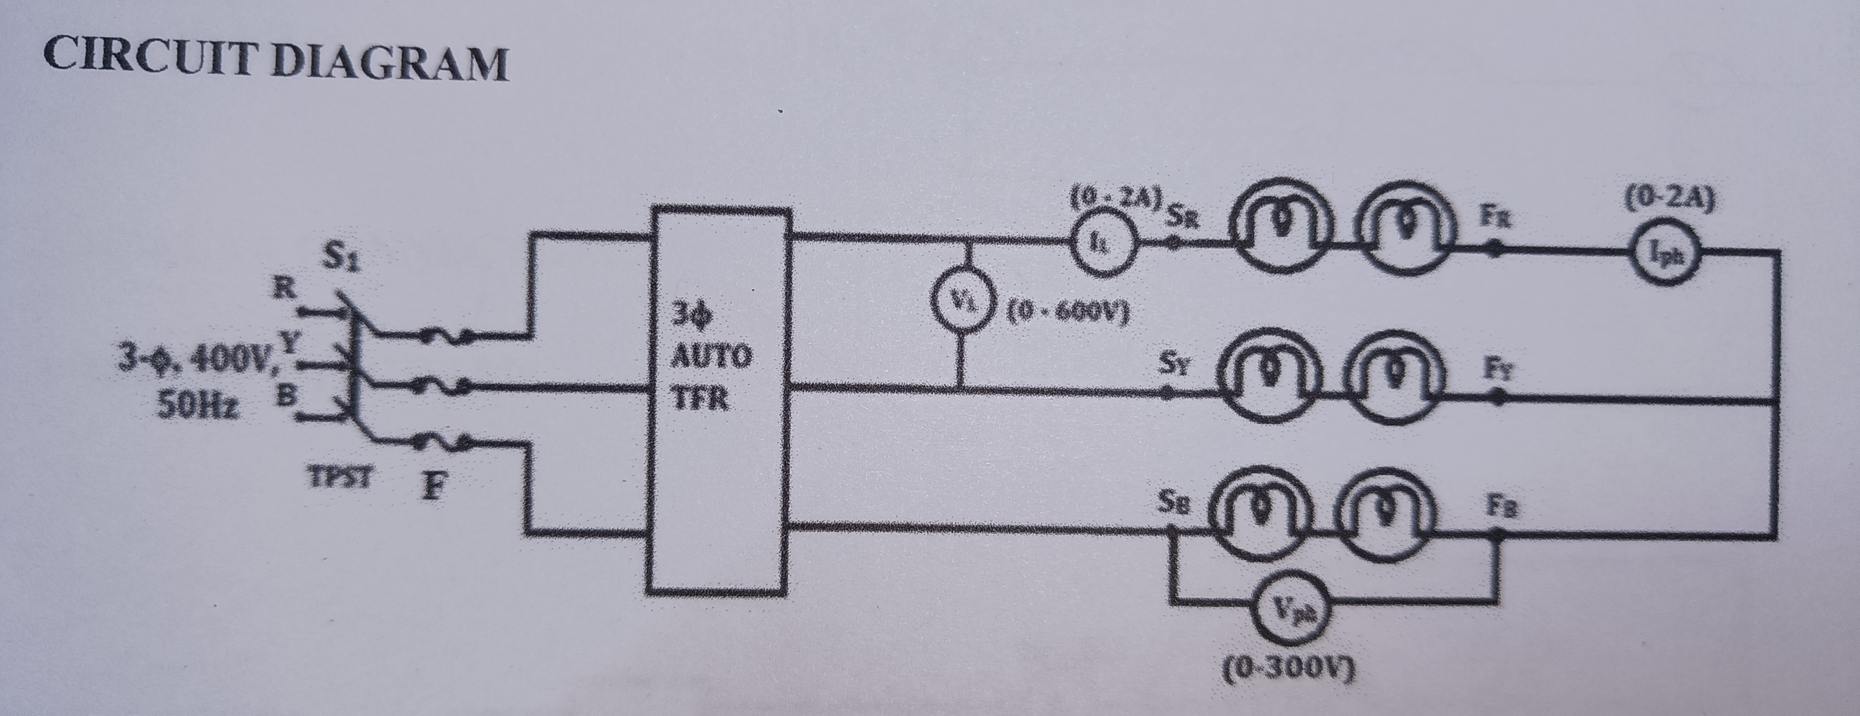
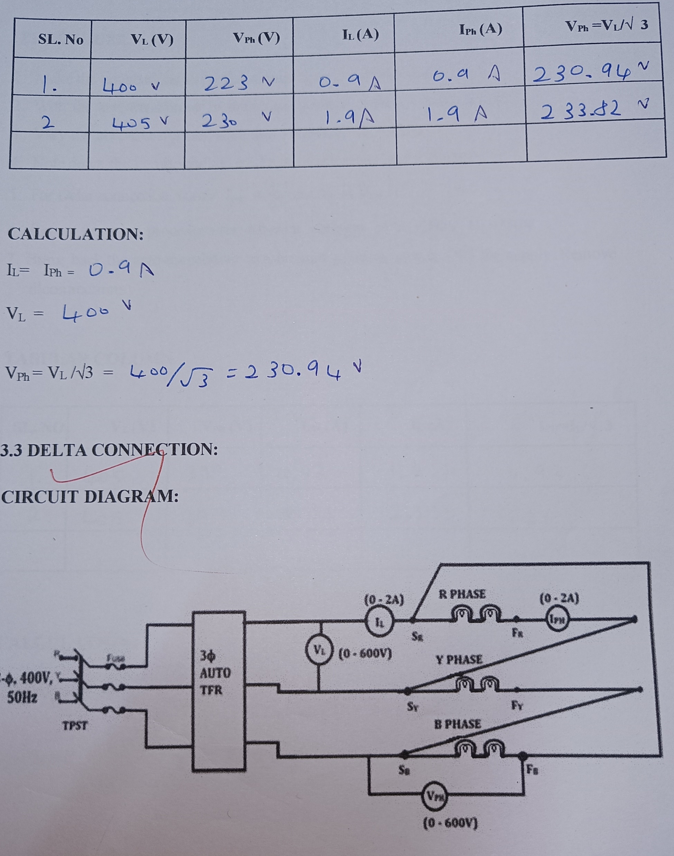
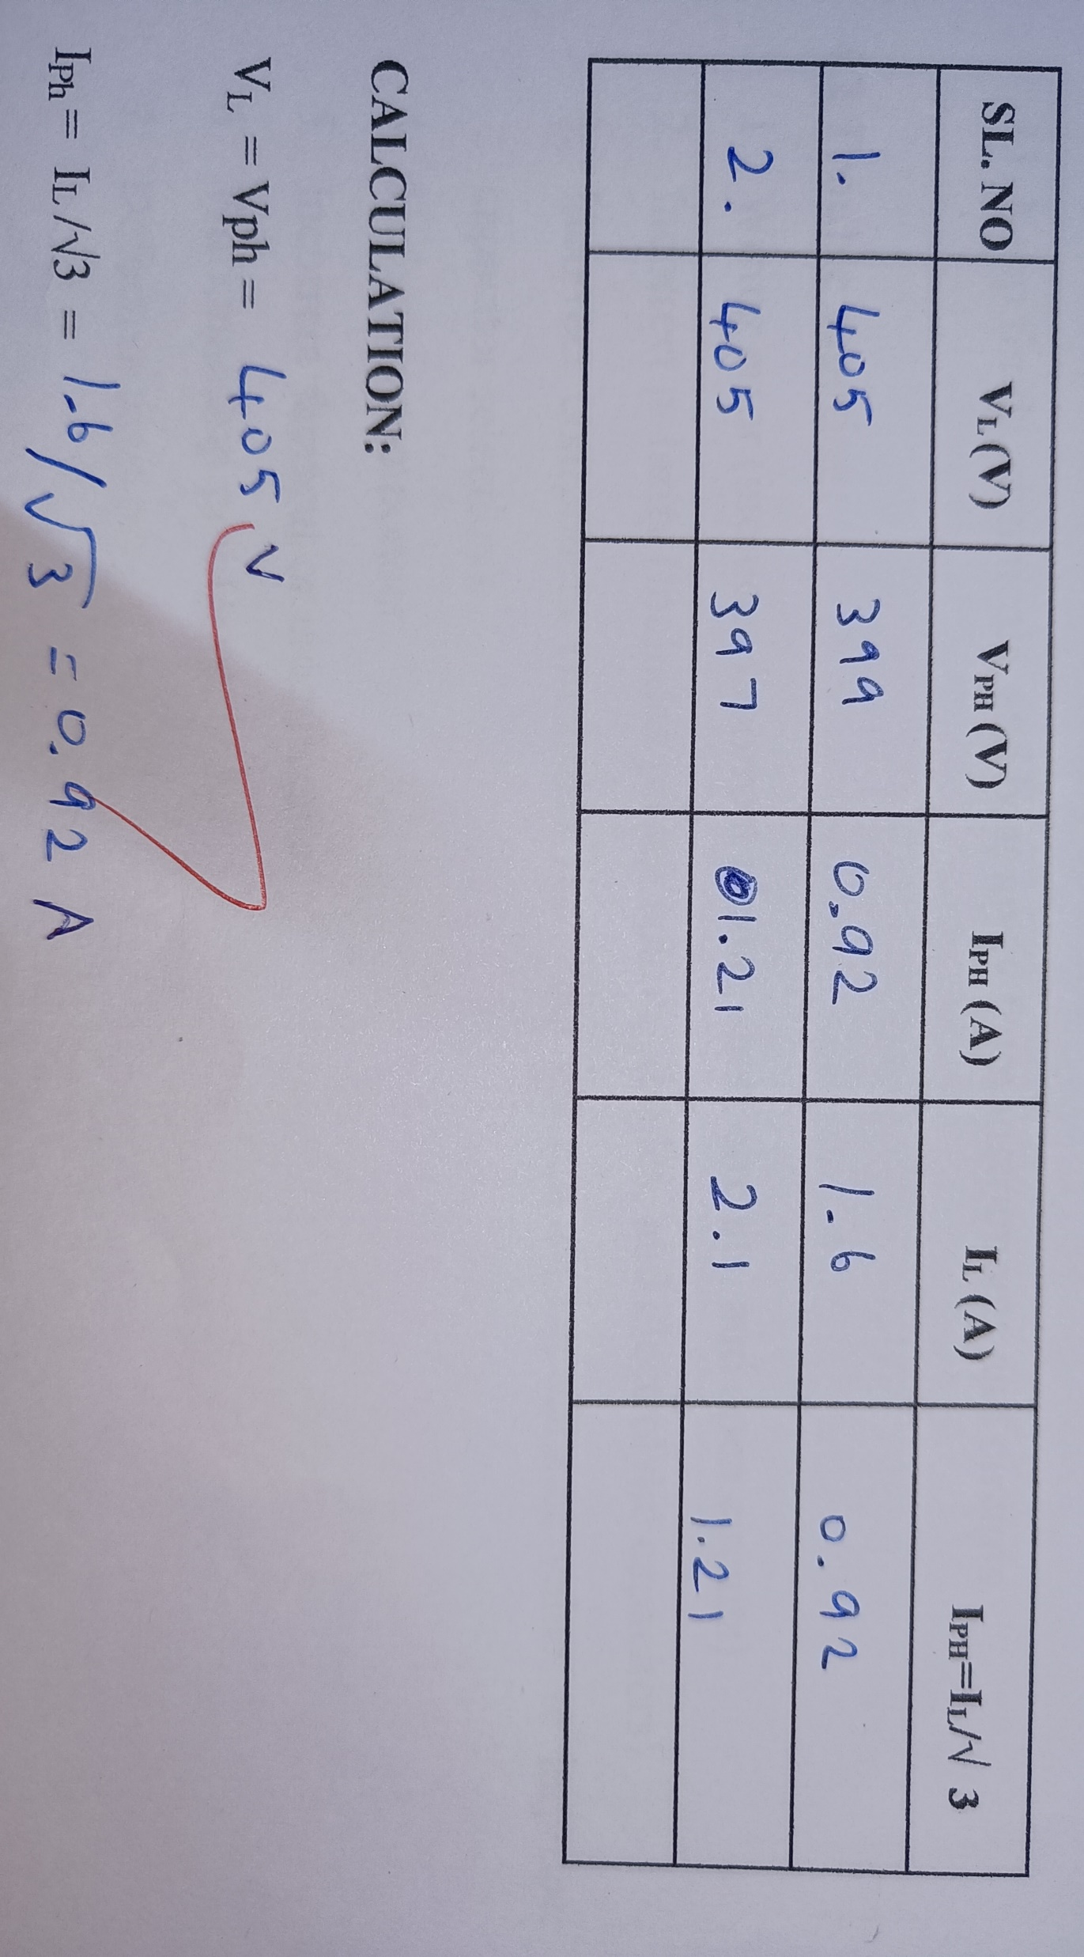
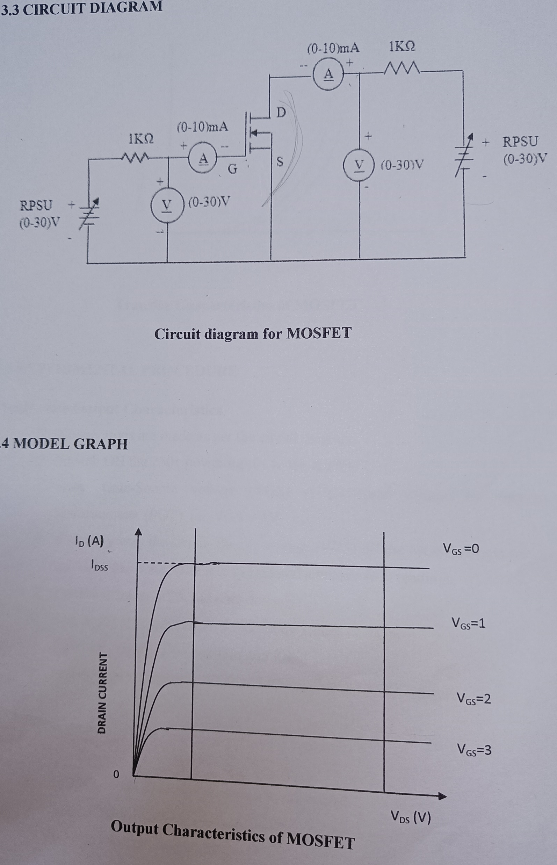
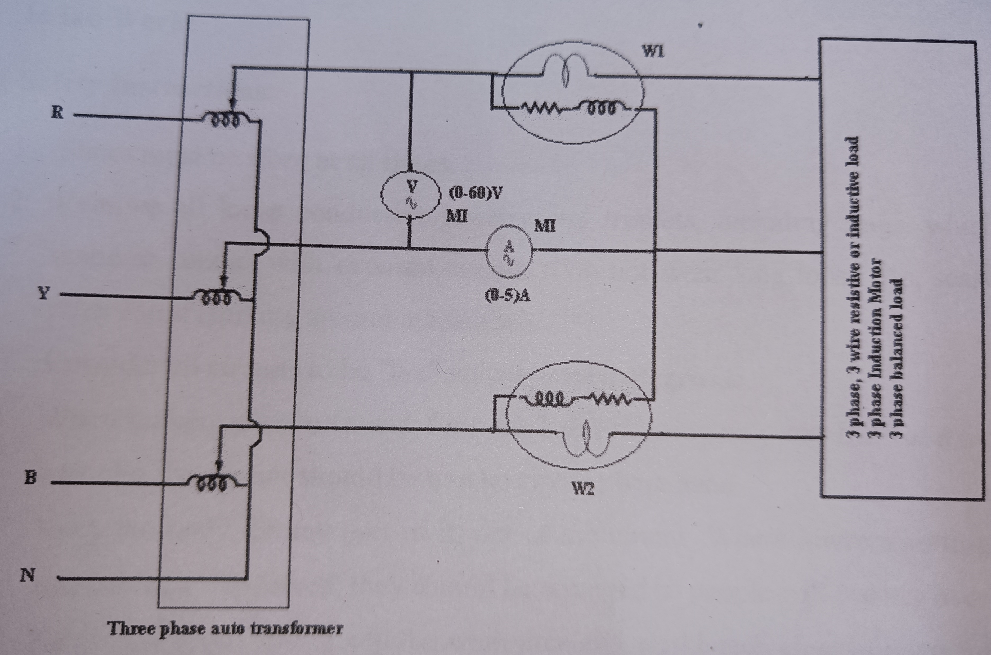
MEASUREMENT OF THREE PHASE POWER AND POWER FACTOR
Objective:
To measure the active, reactive power and power factor in three phase circuit.
Apparatus Required:
S. No. Apparatus Range/Type Quantity
1. Auto transformer Three phase 1
2. WattmeterDynamometer type,
600V,50 Hz, 5A, UPF 2
3. Ammeter (0-5)A/MI 1
4. Voltmeter (0-60)V/MI 1
5. Load Three phase 1
6. Connecting wires - Few
CHARACTERISTICS OF MOSFET
1. OBJECTIVES
To obtain the steady state output and transfer characteristics of MOSFET.
2. APPARATUS REQUIRED
STAR AND DELTA CONNECTIONS
1. Aim ::To determine phase and line quantities in three phase star and delta connected loads.
2. Apparatus Required
Sl. NO. NAME OF EQUIPMENT RANGE QUANTITY
1 Fuse board with TPST 15A/250V 1 No.
2 3φ Auto-transformer 0-400V 1 No.
3 A.C Voltmeter 0-400V 2 No.
4 A.C Ammeter 0-10A 2 No.
5. Lamp Load 1 No.
S.No Component name Range Qty
1. MOSFET 1
2. Resistors Required Values 2
3. Ammeter (0-10) mA, M.C 2
4. Voltmeter (0-50) V, M.C 2
5. Patch chords As Required
PROCEDURE
Steady state Output Characteristics
1. Connections are made as per the circuit diagram.
2. Switch ON the 230v power supply to the module.
3. Keep Gate-Source voltage (VGS) at particular voltage by varying the
potentiometer (POT). i.e. VGS = 4V.
4. Smoothly vary the Drain- Source voltage (VDS) till the MOSFET gets turned ON
and note down the voltmeter (VDS) and ammeter (ID) readings.
5. Further increase VDS and note down ID.
6. Repeat the same procedure for different values of VGS.
7. From the reading calculate Gm and Rds.
8. Draw the graph between VDS and ID keeping the VGS constant.
procedure:
1. Connect the voltmeter, ammeter and wattmeter load through three phase auto
transformer as given in the circuit diagram.
2. Switch ON the three phase AC supply and adjust the auto transformer till a suitable voltage.
3. Note down the readings.
4. Vary the voltage and note down the readings.
5. Switch OFF and disconnect the equipment.
PROCEDURE: STAR CONNECTYION
1. Make the connections as per the circuit diagram shown in Fig.
2. With the auto-transformer in minimum position, switch ON the supply.
3. Vary the auto-transformer such that voltmeter VL = 150V.
4. Note down the corresponding readings of ammeters and voltmeters.
5. For star connection, verify Vph =VL/√3 and IL =Iph
6. Repeat the same procedure for different voltages of VL=200V, VL=250V.
7. Bring back the auto-transformer to minimum position, switch OFF the supply.
Remove allconnections.
PROCEDURE:
1. Make the connections as per the circuit diagram shown in Fig.
2. With the auto-transformer in minimum position, switch ON the supply.
3. Vary the auto-transformer such that voltmeter VL = 150V.
4. Note down the corresponding readings of ammeters and voltmeters.
5. For Delta connection, verify Iph=IL/√3 and VL=Vph
6. Repeat the same procedure for different voltages of VL=200V, VL=250V.
7. Bring back the auto-transformer to minimum position, switch OFF the supply. Remove
allconnections.

Slide 3
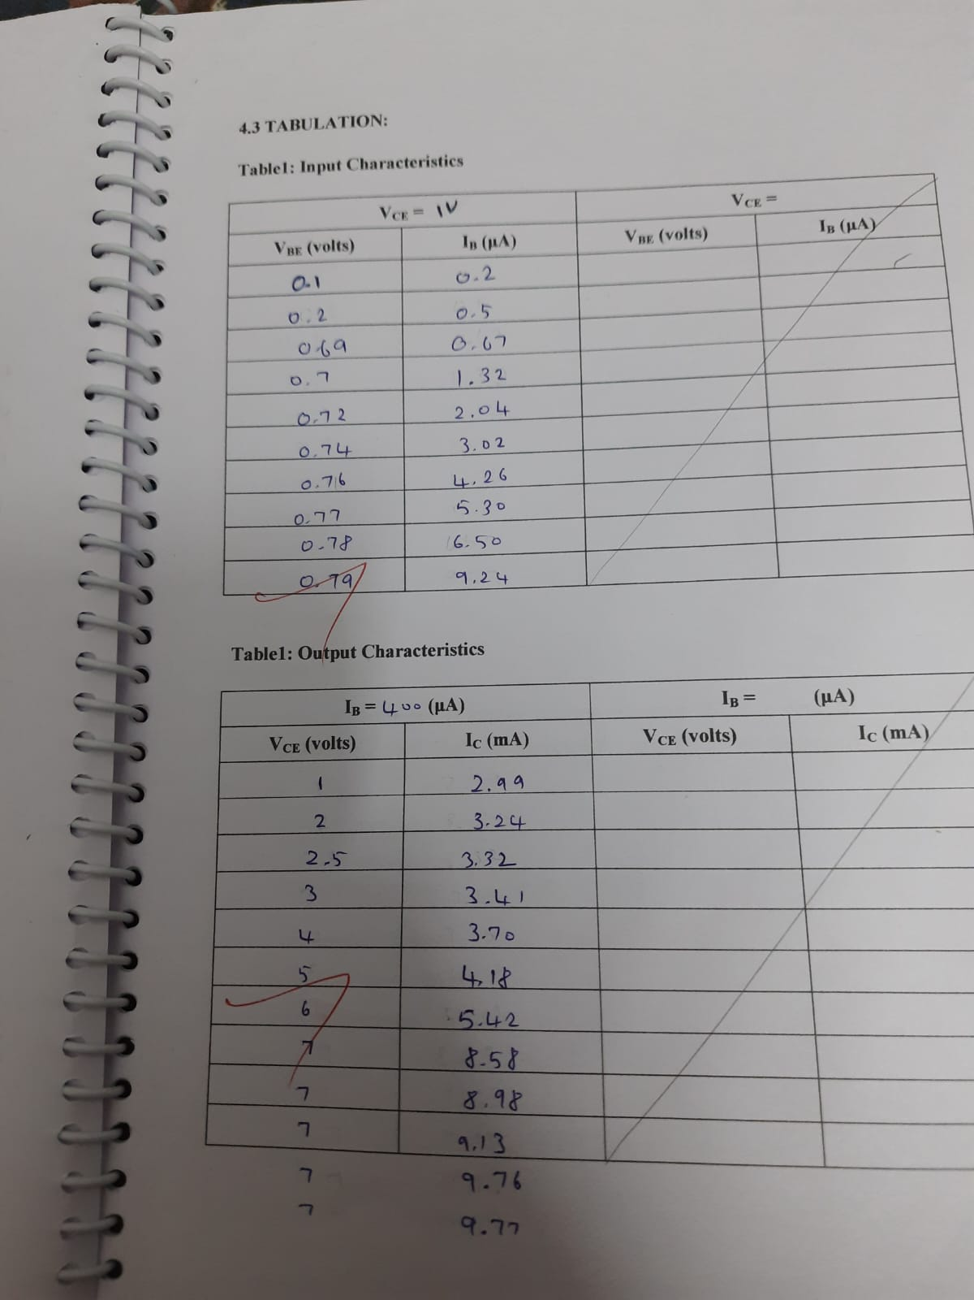
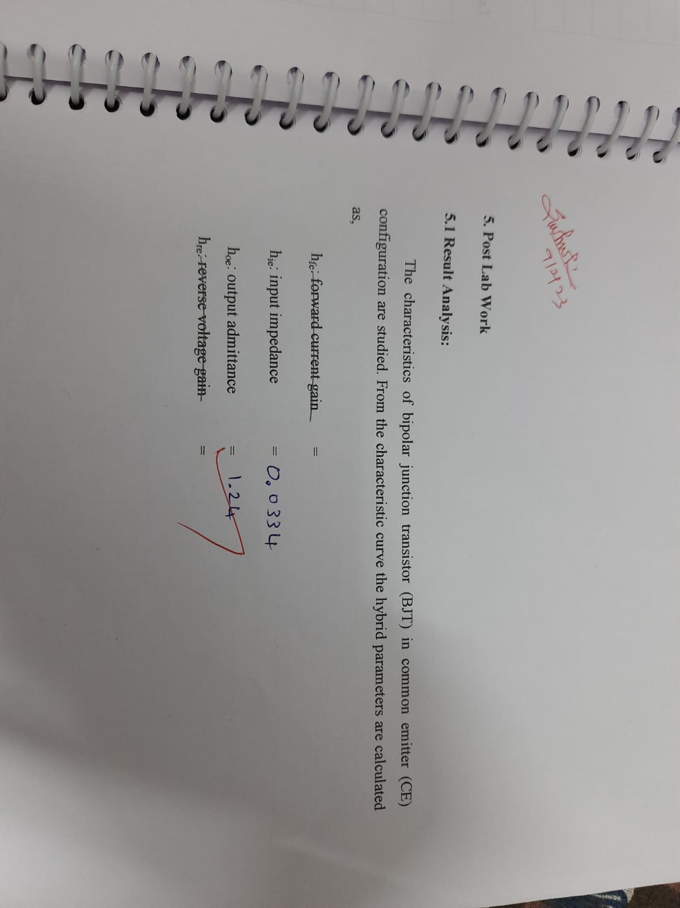
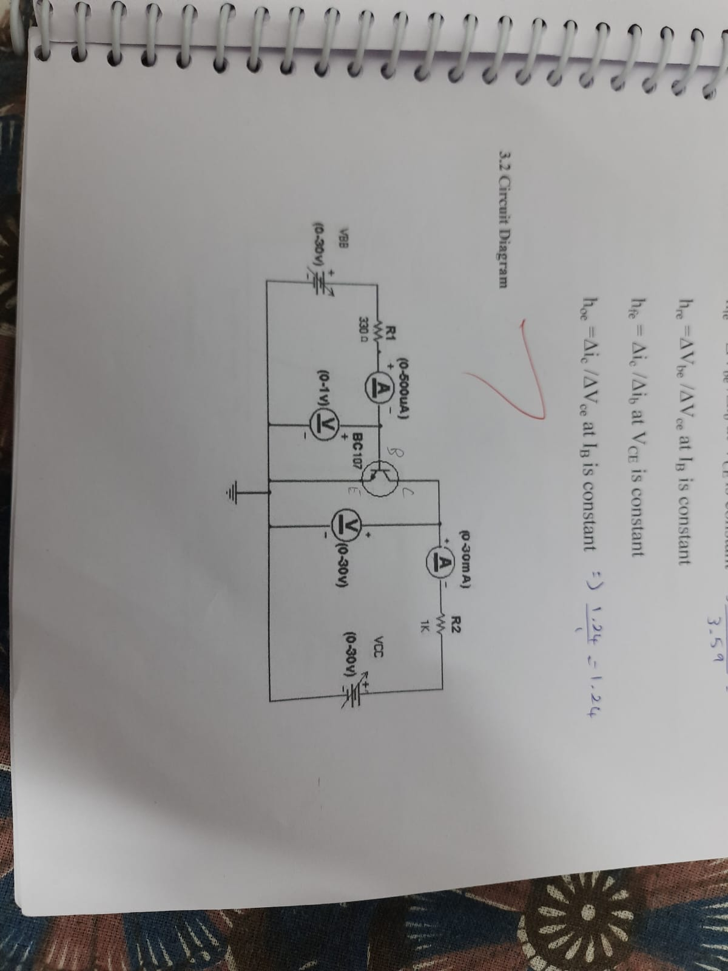
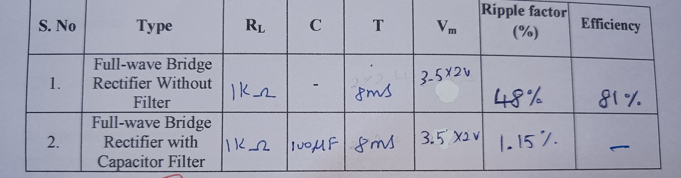
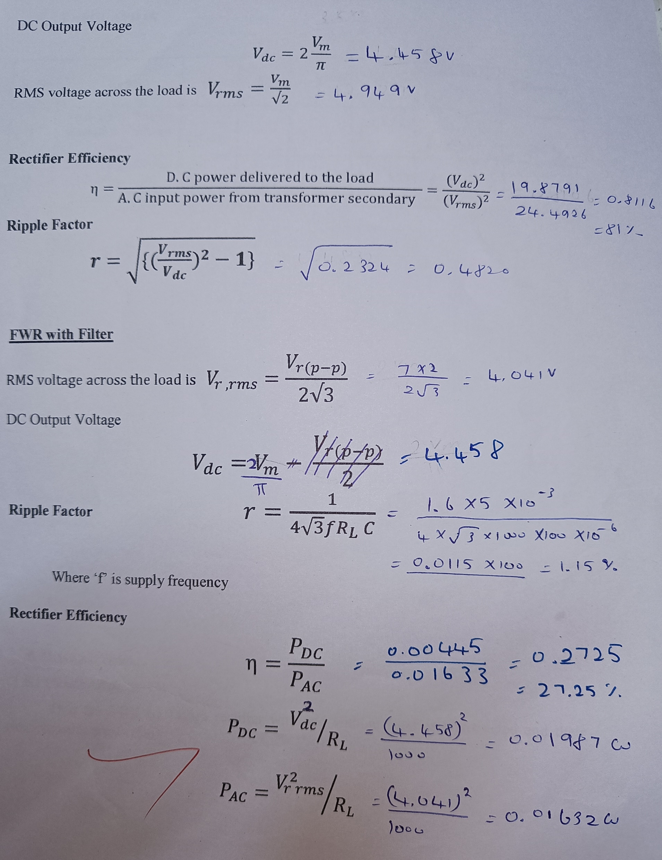
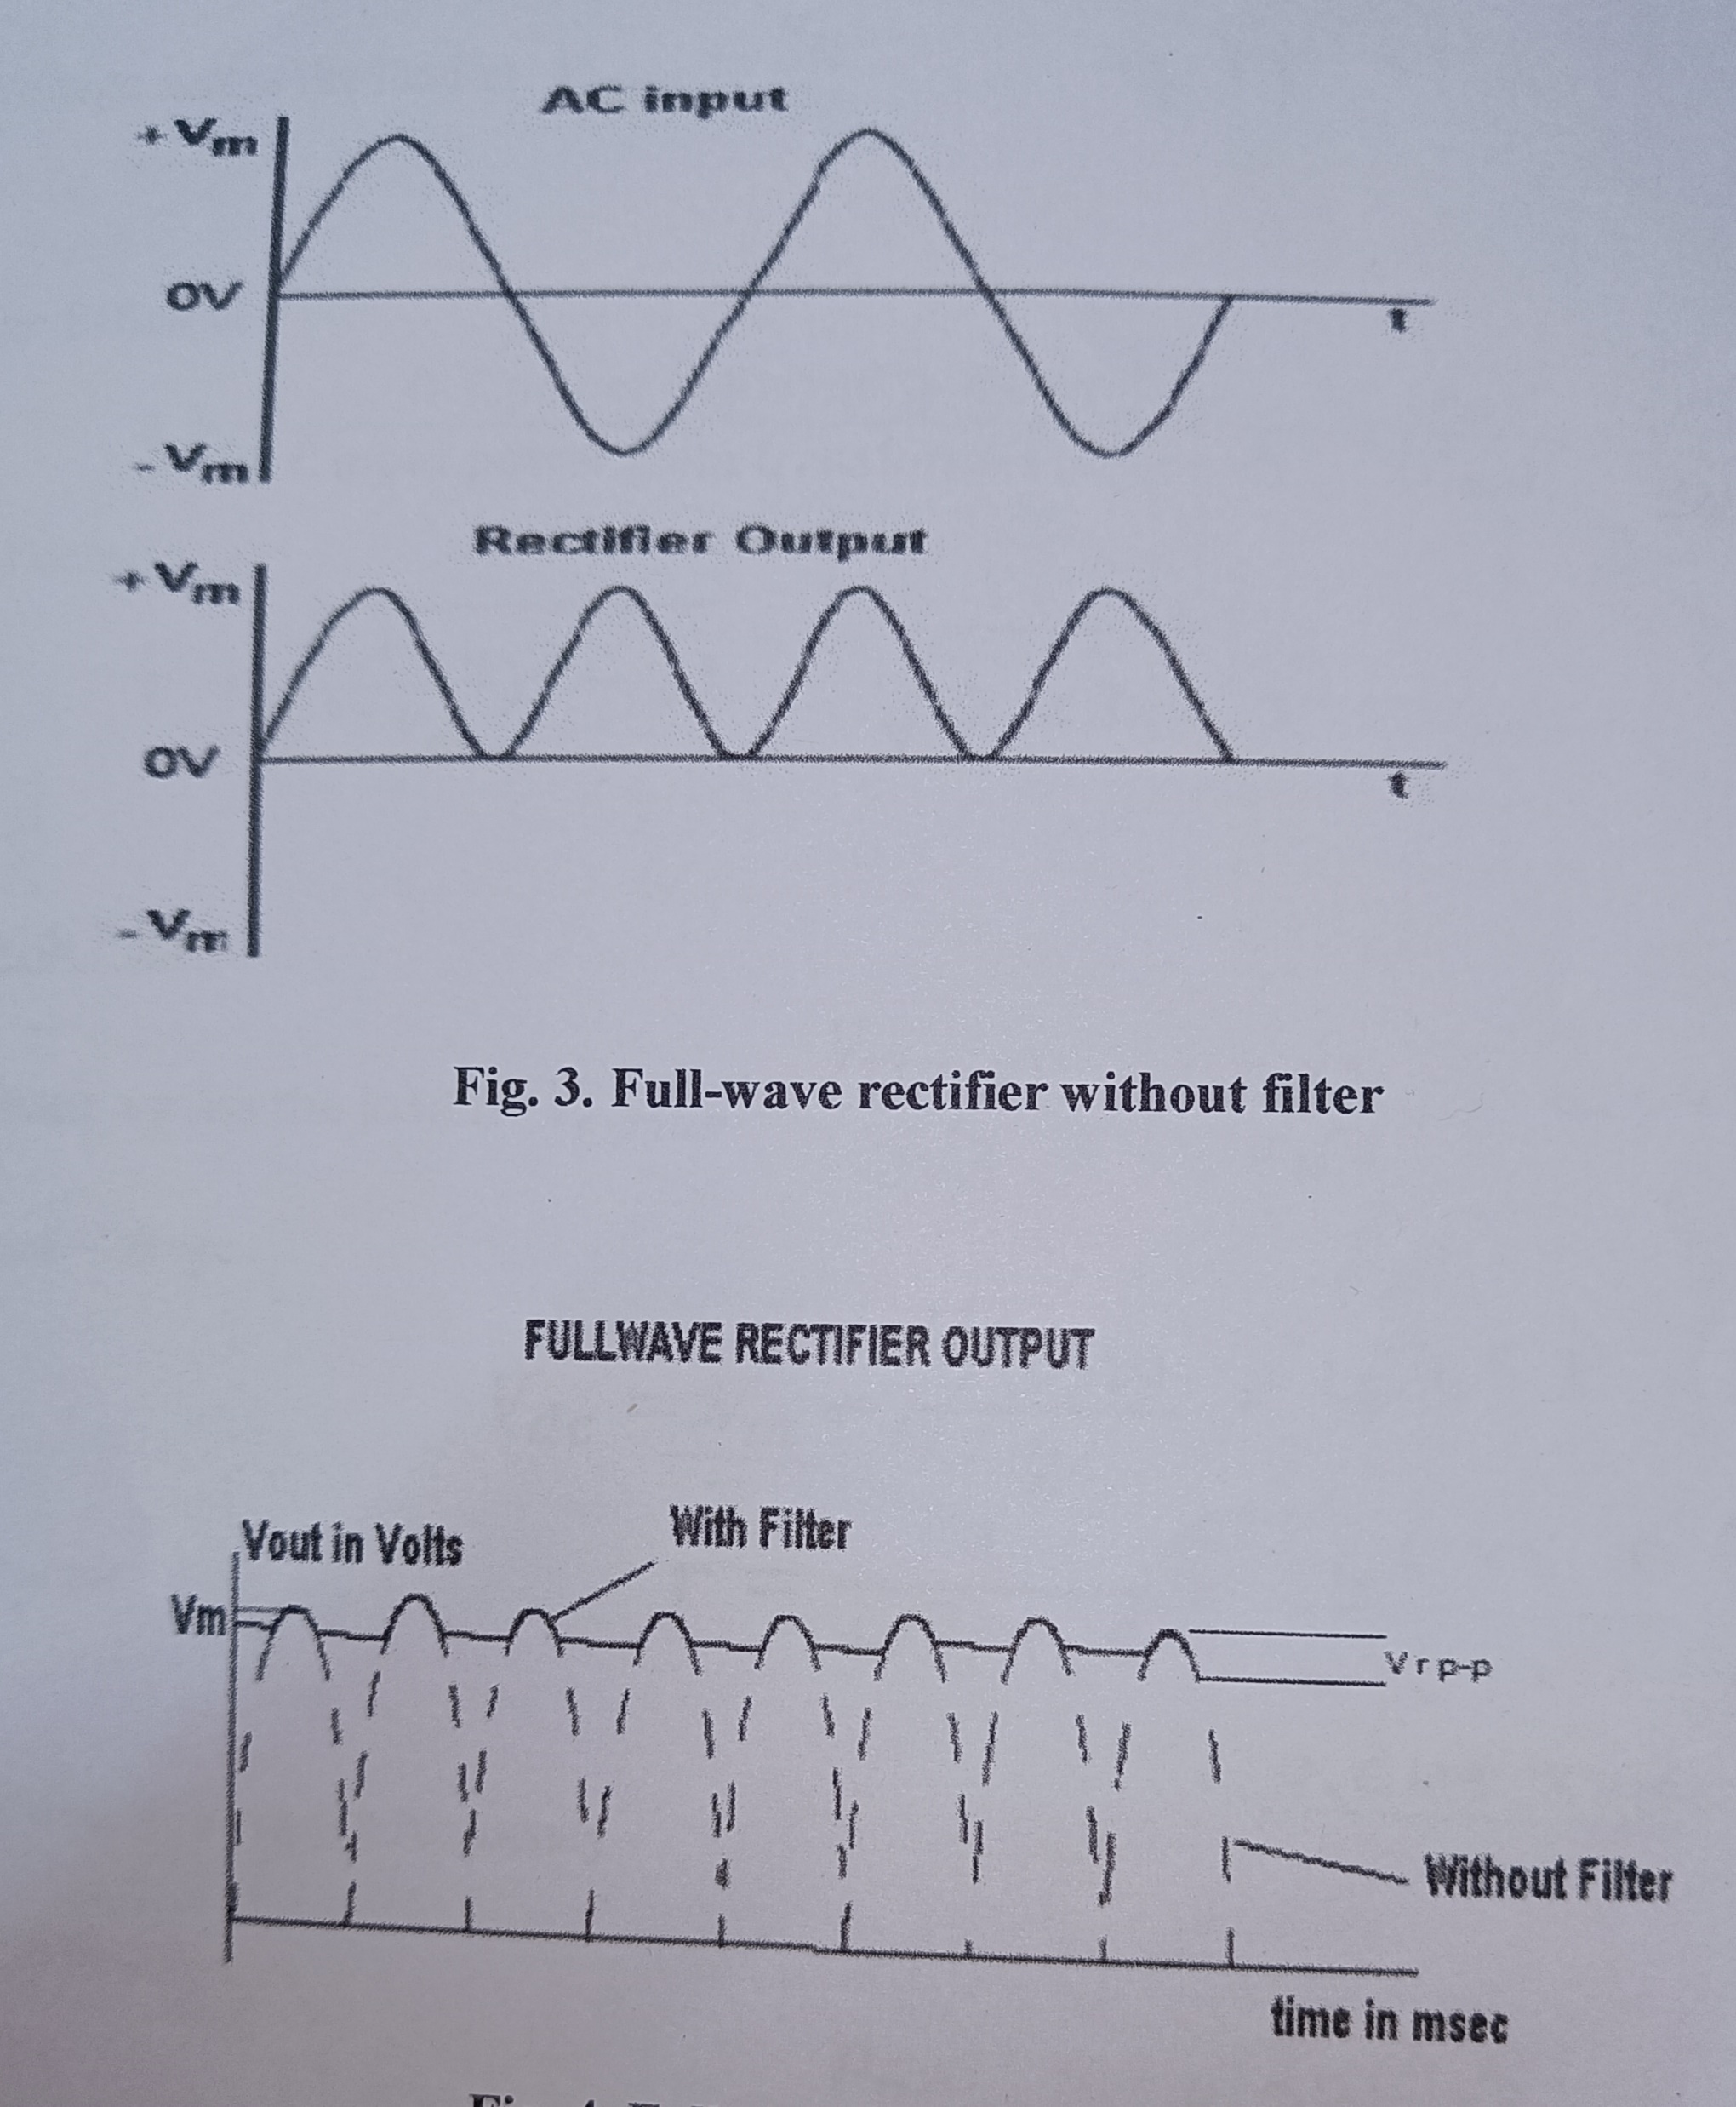
BRIDGE RECTIFIER WITH AND WITHOUT FILTER
1. Objectiv::
The purpose of the experiment is to construct and study the characteristics of full-
wave bridge rectifier with and without filter.
2. Apparatus Required
S. No . Components Range/Type Quantity
1. Diode 1N4007 orBY127 4
2. Resistor 1.0 kΩ 1
3. Capacitor 100μF 1
4. Step down transformer, 230V/12V 1
Multimeter - 1
6. Dual trace Oscilloscope - 1
PROCEDURE
1. Connections are made as per the circuit diagram, with correct polarity provision given
to the circuit from the transformer.
2. The Peak voltage (Vm) is noted and the corresponding efficiency (η) %, ripple
factor(r) % and the voltage regulation % is calculated and compared with theoretical
calculation.
BIPOLAR JUNCTION TRANSISTOR
1. Objective:
To study the characteristics of bipolar junction transistor (BJT) in common emitter
(CE) configuration.
2. Apparatus Required:
S. No. Components Range/Type Quantity
1. BC107 - 1
2. Resistor 1.0kΩ 330Ω 1
3. Dual Regulated Power Supply (0-30V) 1
4. DC Ammeters (0 - 30)mA(0-500) μA 1
5. DC Voltmeters (0 - 30)V 1
6. Breadboard - 1
3.4 Procedure:
Input Characteristics
1. Keeping the output voltage constant (VCE = constant), vary the input voltage and note
down the corresponding VBE voltage and IB current.
2. Repeat the above step for different values of VCE.
3. Plot the graph: IB against VBE for different values of VCE.
4. From the plot, find the h-parameters: i) hfe: forward current gain
ii) hie: input impedance

